Slide 1
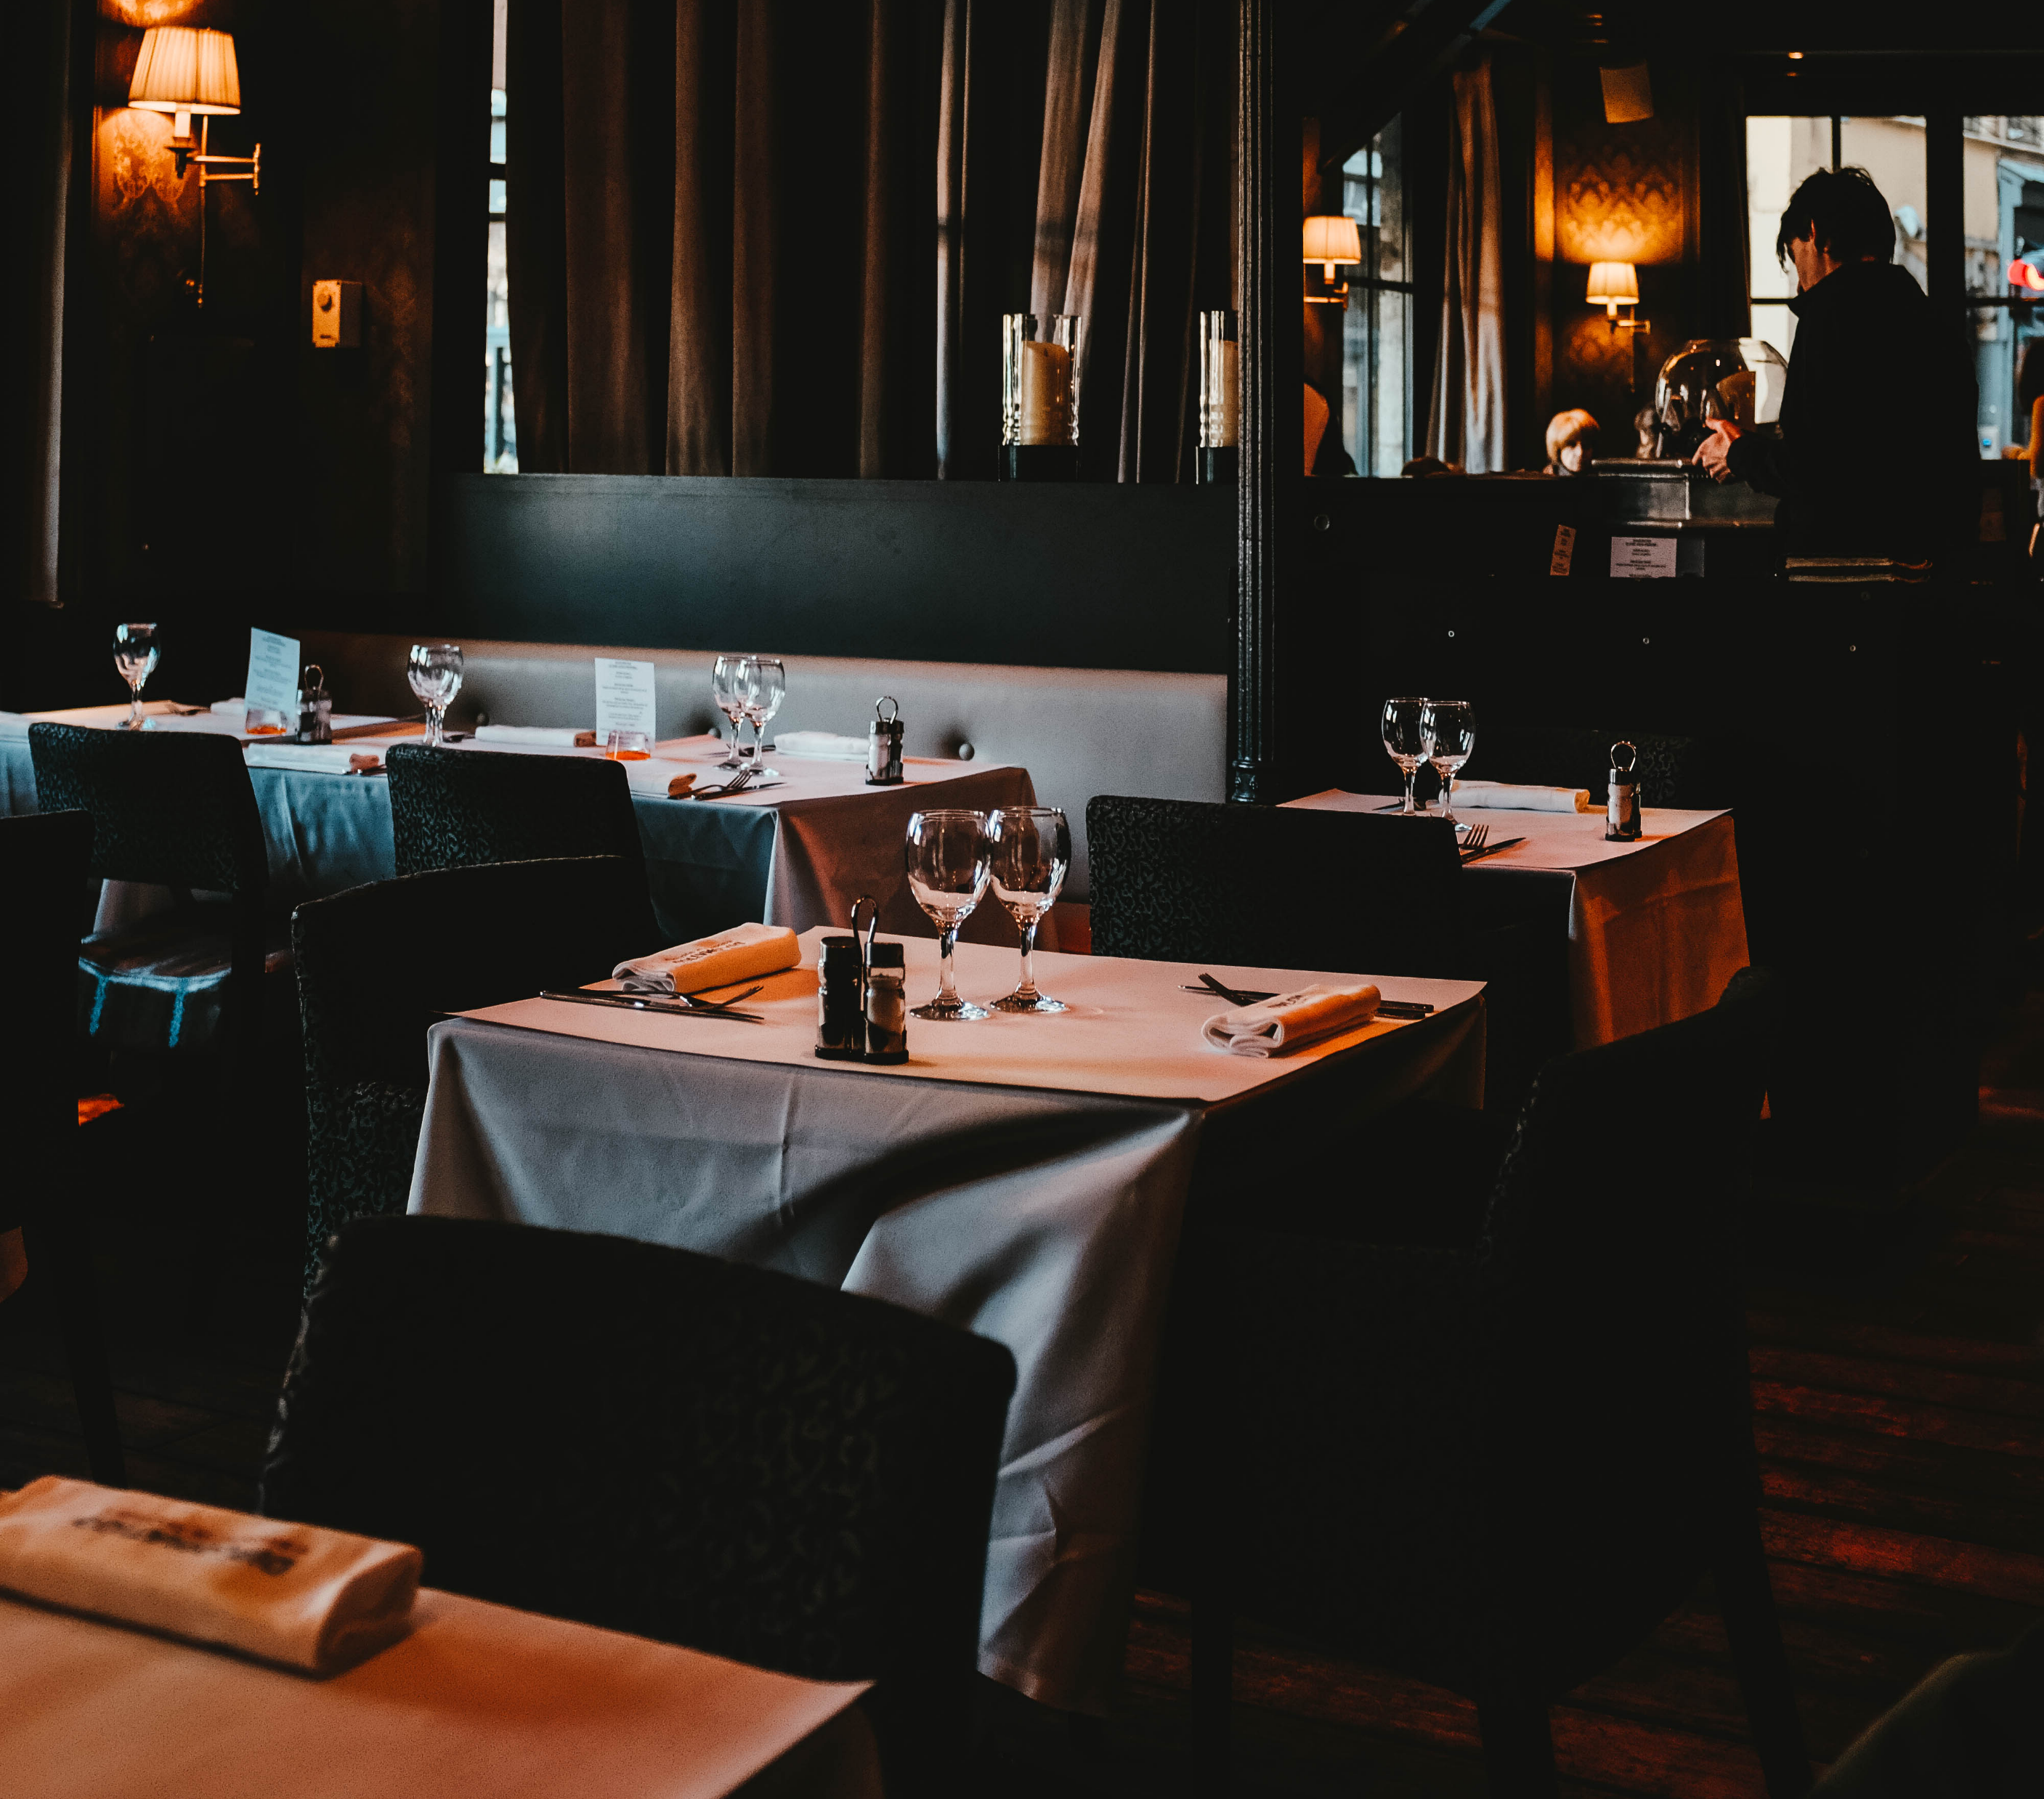
Restaurant Ordering System

Slide 2

Implemented functions
01
02
03
04
Password login interface
Browse menu
Place an order
Checkout
Call the method to add the selected dish name and price to the order. Use boolean to judge whether the order condition is met.
The ordered dishes are added to the table. Traverse the table during checkout and add the price to the variable sum to calculate the total amount.
The login function is realized by processing the button click event through the ActionListener interface
Display the name, picture and price of the dish in one interface.

Slide 3
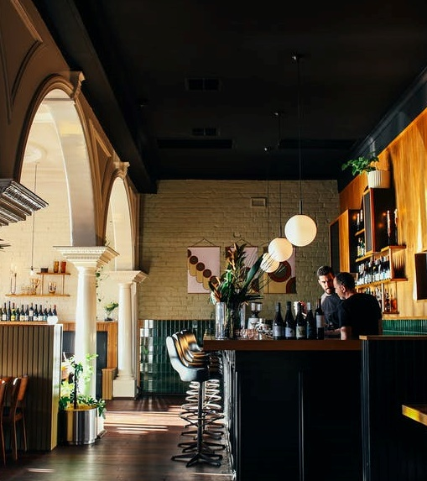
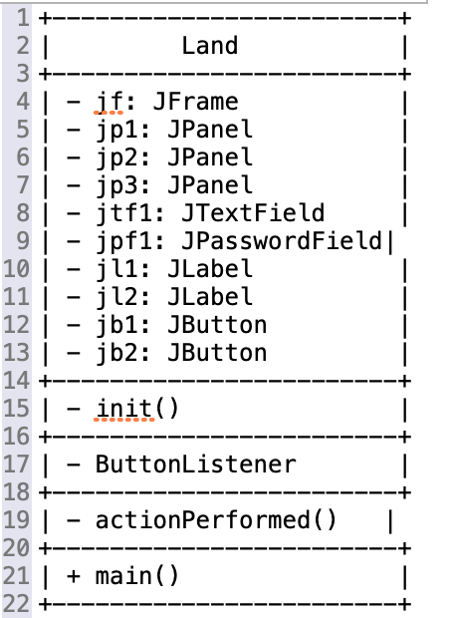
class Land
Implement the system login interface

Slide 4
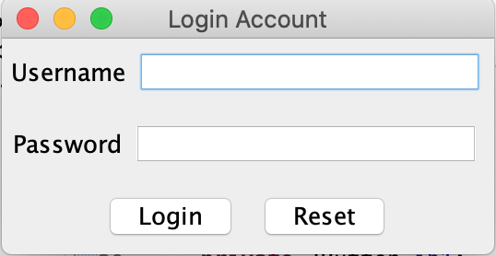
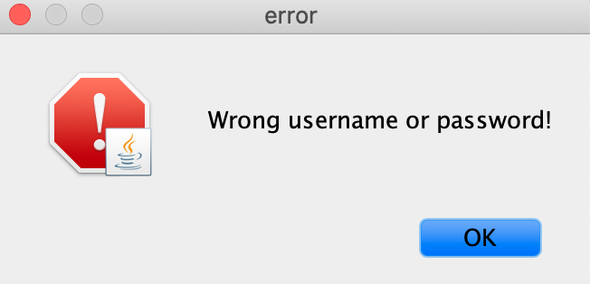
01
02
Login interface
Error message
If the user name and password are correct, the login is successful, the current window is hidden and a new System object is created.
If enter a wrong username or password, an error reminder will be displayed and the username and password text boxes will be cleared.

Slide 5
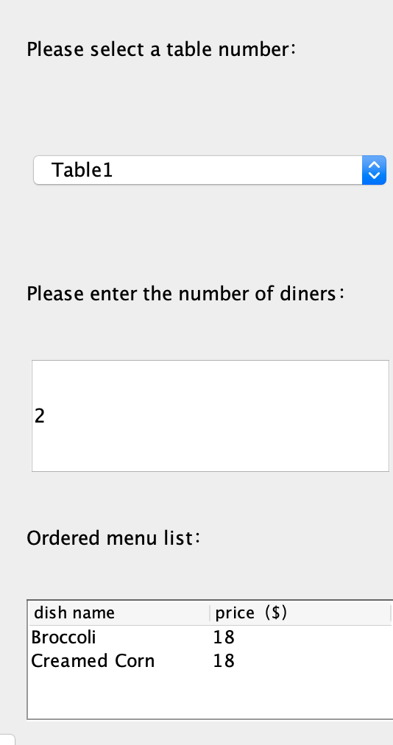
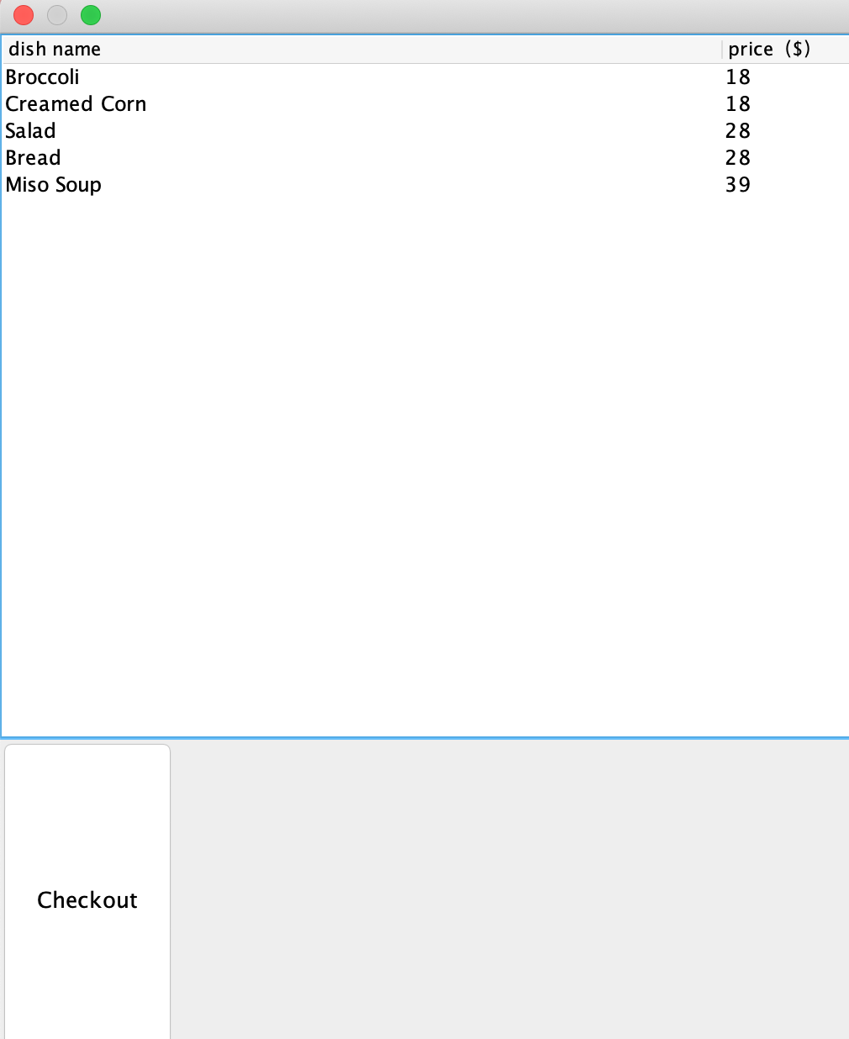
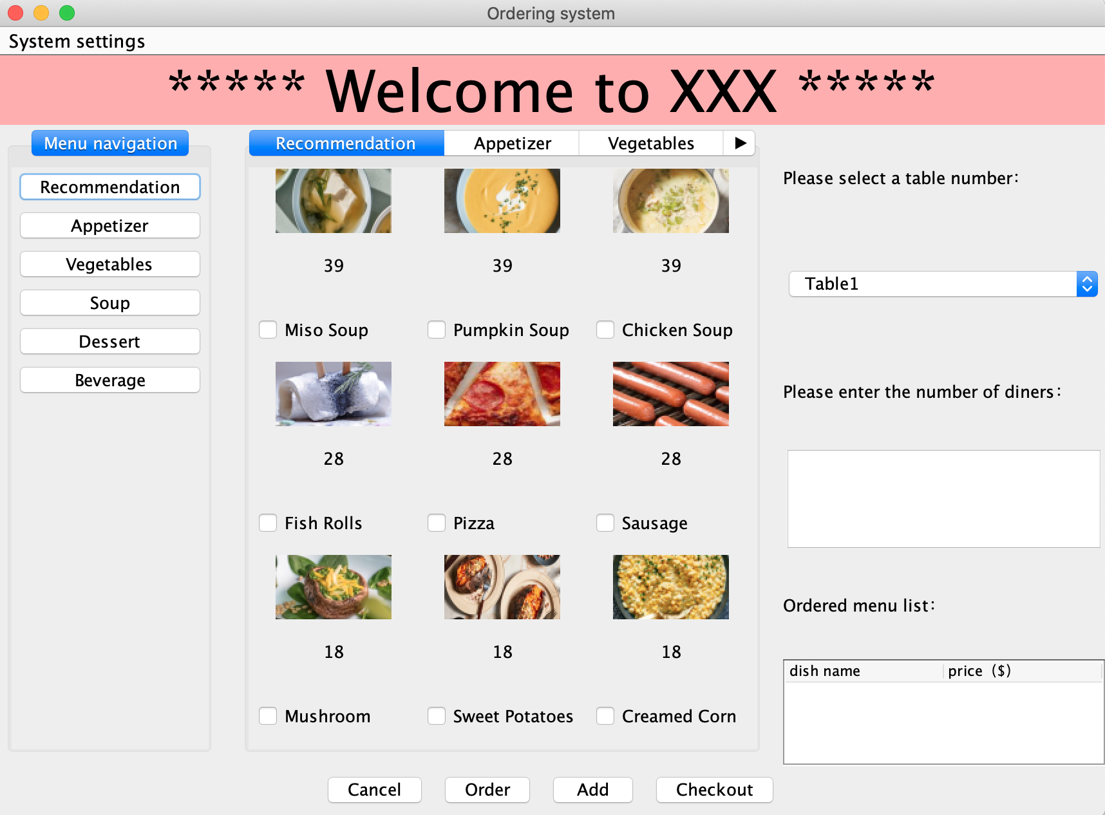
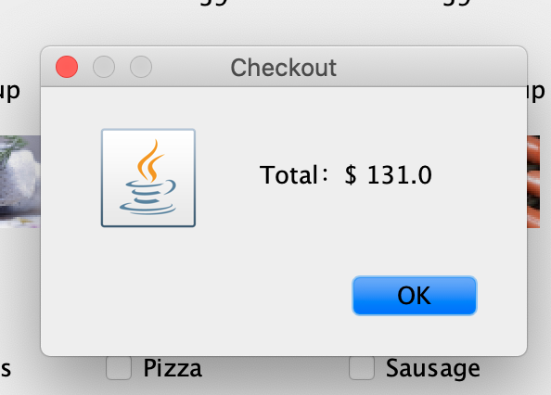
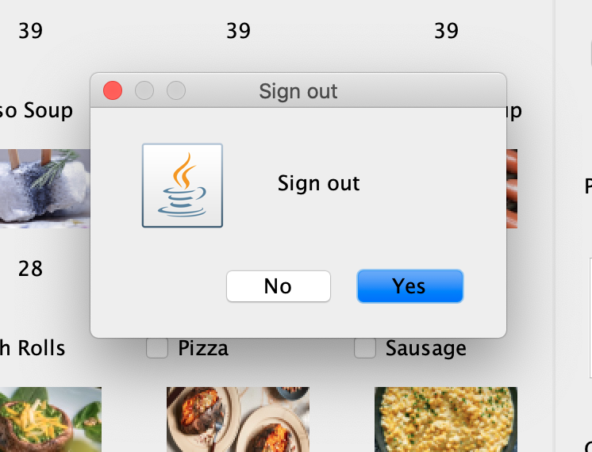
class System1

Slide 6
Functions that could be improved/added
01
02
03
Connect to the database
Improve system
Add function
Allow restaurant administrators to add or remove items from the menu
Add the function of takeaway. Match the customer's personal information with the the order.
Store customer information in a database.

Slide 7
Thank you

